Slide 1



Generative AI with Databricks
From Concept to Deployment
©2023 Databricks Inc. — All rights reserved

Slide 2




Today’s Speakers
JK Wong
Sr. Partner Solutions Architect
jk.wong@databricks.com
Andrew Kennedy Sr. Data & AI Consultant
andrew.kennedy@thorogood.com
©2022 Databricks Inc. — All rights reserved

Slide 3
Agenda
Who is Databricks?
What is Generative AI and the impact on Global Economy
Databricks Data Intelligent Platform
Use Case References
Knowledge discovery and search (Demo)
©2023 Databricks Inc. — All rights reserved

Slide 4








10,000+
global customers
Inventor of the lakehouse
&
Pioneer of generative AI
Creator of
$1.5B+
in revenue
The data and AI company
Gartner-recognized Leader
Database Management Systems
Data Science and Machine Learning Platforms
$4B
in investment
Mosaic MPT
©2023 Databricks Inc. — All rights reserved

Slide 5


What is Generative AI?
Artificial Intelligence (AI)
Artificial Intelligence:
A multidisciplinary field of computer science that aims to create systems capable of emulating and surpassing human-level intelligence.
Machine Learning (ML)
Deep Learning (DL)
Generative AI
Machine Learning:
Learn from existing data and make predictions/prediction without being explicitly programmed.
Deep Learning:
Uses “artificial neural networks” to learn from data.
©2021 Databricks Inc. — All rights reserved

Slide 6
What is Generative AI?
Generative AI:
Sub-field of AI that focuses on
generating new content such as:
Text
Code
Images
Audio/music
Video
3D objects
Synthetic data
Artificial Intelligence (AI)
Machine Learning (ML)
Deep Learning (DL)
Generative AI
©2021 Databricks Inc. — All rights reserved

Slide 7
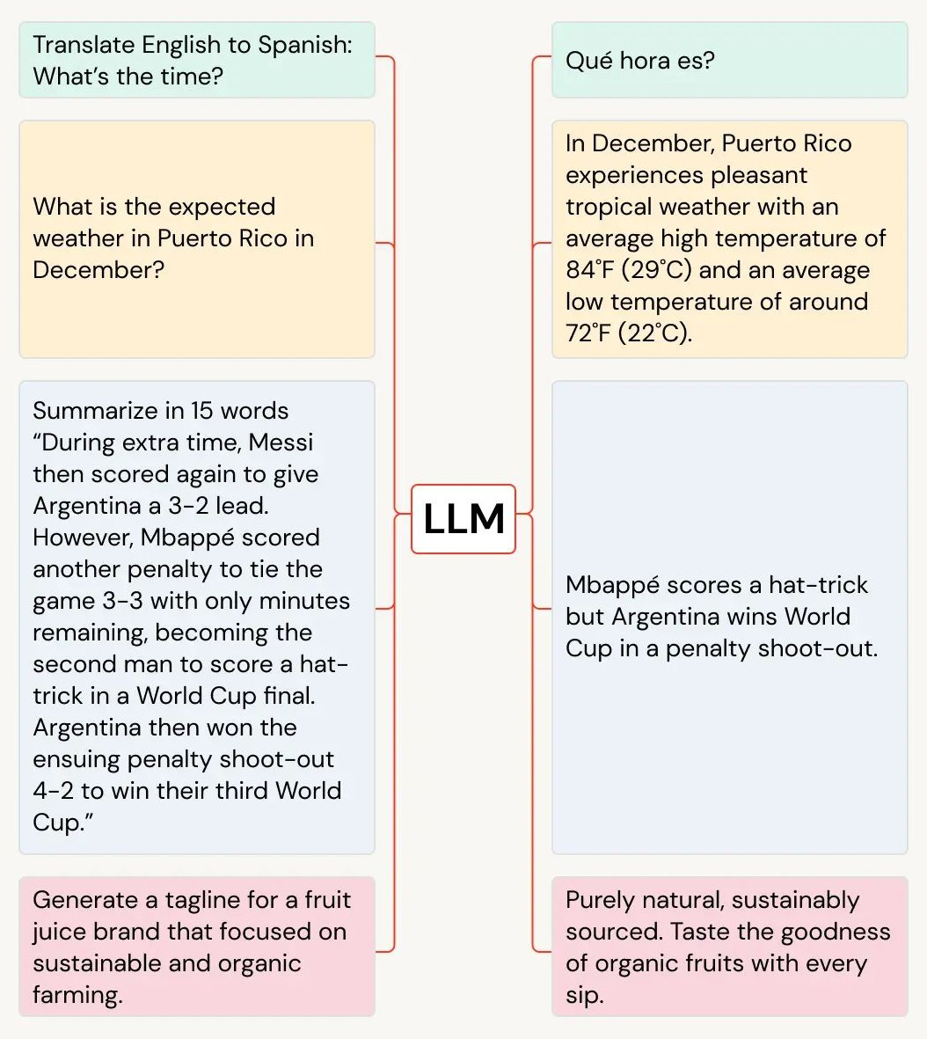
Generative AI use cases
Question and answers
Content generation
Content personalization
Translation
Language style transfer
Story telling, creative writing
Code generation, auto-completion
©2021 Databricks Inc. — All rights reserved

Slide 8
Generative AI impact on global economy
Generative AI is expected to create significant value over and above what traditional AI and Analytics are expected to deliver
AI’s potential impact on the global economy, $trillion
17.1–25.6
13.6–22.1
11.0–17.7
 |  | ~15–40% incremental economic impact |  | ~35–70% incremental economic impact
Advanced analytics, traditional machine learning, and deep learning
New generative AI use cases
Total use case-driven potential
All worker productivity enabled by generative AI, including in use cases
Total AI economic potential
McKinsey – The economic potential of generative AI: The next productivity frontier
©2021 Databricks Inc. — All rights reserved

Slide 9
The winners in every industry will be data + AI companies
©2023 Databricks Inc. — All rights reserved

Slide 10






Gen AI will disrupt use cases across industries
Financial Services
Healthcare & Life Sciences
Comm, Media & Entertainment
Retail & Consumer Goods
Manufacturing
Public Sector
Fraud monitoring and predictions
Biomedical literature summarization & discovery
Hyper-personalization for customer experience (CX)
Try before you buy with virtual fitting rooms
Delightful, personalized customer experiences
Analysis of open-source Intelligence
Automating compliance data gathering
Clinical trial optimization
Enhancing customer support and self-service
Optimizing demand prediction and inventory
Increasing productivity and efficiency in operations
Modernizing legacy code bases
Accelerate underwriting and claims processing in insurance
Health insurance claim processing
Intelligent content creation and curation
Generate innovative product designs
Prescriptive and proactive field service
Regulatory compliance assistance
©2021 Databricks Inc. — All rights reserved

Slide 11


Impact
1st
Challenge
The Rangers wanted to unlock the potential of massive, diverse data sets and combine it with the power of AI to help deliver best-in-league player performance and amazing fan experiences
Solution
Databricks unifies data from different sources-biomechanics, weather, consumer- and delivers AI-driven analytics that help boost player pitch and hit rates and prevent injuries. LLMs are in beta to streamline player ops, and personalize in-stadium experiences with chatbots
ever World Series Championship
©2023 Databricks Inc. — All rights reserved

Slide 12

The Data Lakehouse
2020
Databricks pioneered the lakehouse architecture
An open, unified foundation for all your data
Data Science & AI
Mosaic AI
ETL &
Real-time Analytics
Delta Live Tables
Orchestration
Workﬂows
Data Warehousing
Databricks SQL
Today
74% of global enterprises have adopted lakehouse
MIT Technology Review Insights, 2023
Unified security, governance, and cataloging
Unity Catalog
Unified data storage for reliability and sharing
Delta Lake UniForm
Open Data Lake
All Raw Data
(Logs, Texts, Audio, Video, Images)
©2023 Databricks Inc. — All rights reserved

Slide 13
Data Lakehouse
An open, unified foundation for all your data
Data Intelligence Platform
Democratize data + AI across your entire organization
Generative AI
Easily scale and use data and AI
©2023 Databricks Inc. — All rights reserved

Slide 14
Databricks Data Intelligence Platform
Data Science & AI
Mosaic AI
ETL &
Real-time Analytics
Delta Live Tables
Orchestration
Workﬂows
Data Warehousing
Databricks SQL
Unified security, governance, and cataloging
Unity Catalog
Unified data storage for reliability and sharing
Delta Lake UniForm
Open Data Lake
All Raw Data
(Logs, Texts, Audio, Video, Images)
©2023 Databricks Inc. — All rights reserved

Slide 15
Databricks Data Intelligence Platform
ETL &
Real-time Analytics
Delta Live Tables
An AI powered data intelligence engine to understand the semantics of your data
DatabricksIQ
Data Science & AI
Mosaic AI
Orchestration
Workﬂows
Data Warehousing
Databricks SQL
Unified security, governance, and cataloging
Unity Catalog
Unified data storage for reliability and sharing
Delta Lake UniForm
Open Data Lake
All Raw Data
(Logs, Texts, Audio, Video, Images)
©2023 Databricks Inc. — All rights reserved

Slide 16
Databricks Data Intelligence Platform
Use generative AI to understand the semantics of your data
Data Intelligence Engine
Mosaic AI
Create, tune, and serve custom LLMs
Delta Live Tables
Automated data quality
Workfiows
Job cost optimized based on past runs
Databricks SQL
Text-to-SQL Text-to-Viz
Data Science & AI
Mosaic AI
ETL &
Real-time Analytics
Delta Live Tables
Orchestration
Workﬂows
Data Warehousing
Databricks SQL
Unity Catalog
Securely get insights in natural language
Unified security, governance, and cataloging
Unity Catalog
Delta Lake UniForm
Data layout is automatically optimized based on usage patterns
Unified data storage for reliability and sharing
Delta Lake
Open Data Lake
All Raw Data
(Logs, Texts, Audio, Video, Images)
©2023 Databricks Inc. — All rights reserved

Slide 17
Databricks Data Intelligence Platform
Mosaic AI
Gen AI
Custom models
Model serving
RAG
End-to-end AI
MLOps/MLﬂow
AutoML
Monitoring
Governance
Use generative AI to understand the semantics of your data
Data Intelligence Engine
Mosaic AI
Create, tune, and serve custom LLMs
Delta Live Tables
Automated data quality
Workfiows
Job cost optimized based on past runs
Databricks SQL
Text-to-SQL Text-to-Viz
Unity Catalog
Securely get insights in natural language
Delta Lake UniForm
Data layout is automatically optimized based on usage patterns
Open Data Lake
All Raw Data
(Logs, Texts, Audio, Video, Images)
©2023 Databricks Inc. — All rights reserved

Slide 18
GenAI Features
©2023 Databricks Inc. — All rights reserved
18

Slide 19

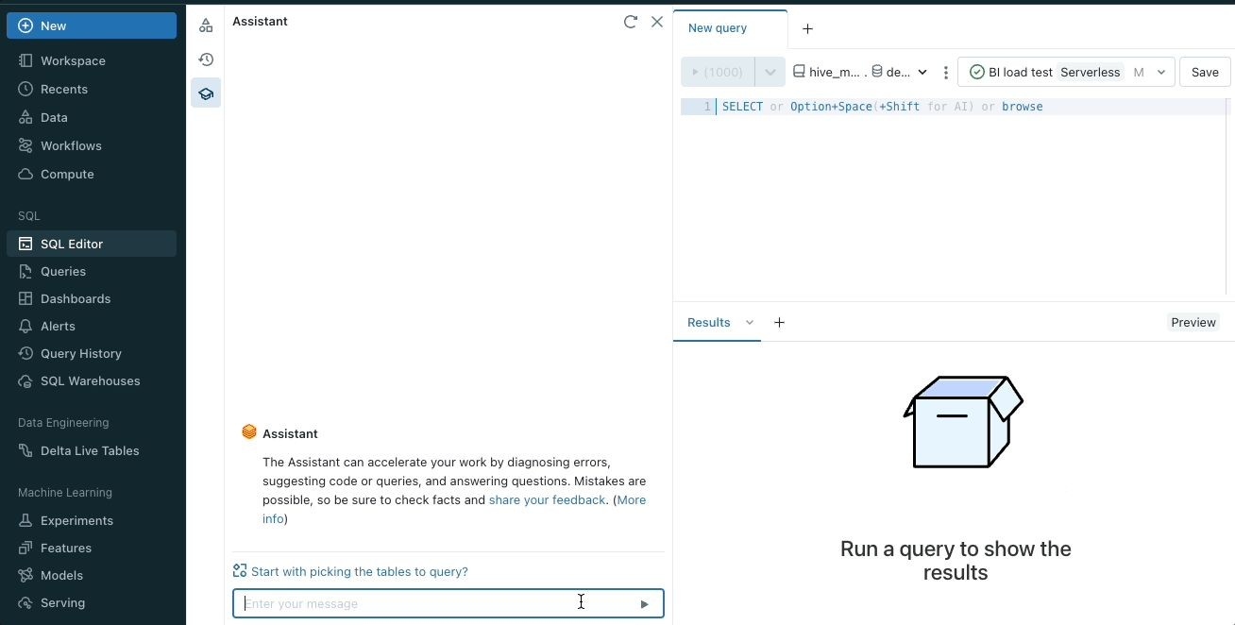
Databricks, powered by AI
Example: Databricks Assistant
AI assistant with contextual understanding of your data— natively within Notebook, SQL editor and file editor.
Generates and auto-completes code and queries
Explains and fixes issues
Integrates with Unity Catalog, offering contextual results relevant to your data assets
©2023 Databricks Inc. — All rights reserved

Slide 20




Models in Marketplace
Curated models - backed by optimized Model Serving
Text embeddings
instructor-xL e5-base-v2
bge-Large-en-v1.5
Simple: Grab the latest open source models in just a few clicks, without writing boilerplate code
Instruction following
MPT-7B-Instruct MPT-30B-Instruct
LLama-2-70b-chat-hf
Optimized: Deploy to Model Serving and scale in a cost-effective and performant way, with automatic optimizations for common model architectures
Transcription
whisper-Large-v2
whisper-medium
Governed: Ensure compliance and governance by managing models from the marketplace in Unity Catalog
Code generation
CodeLLama-34b repLit-code-v1-3b
Image generation
stabLe-diffusion-xL
OSS model guidance: Research team ﬁndings are also published here.
©2023 Databricks Inc. — All rights reserved

Slide 21
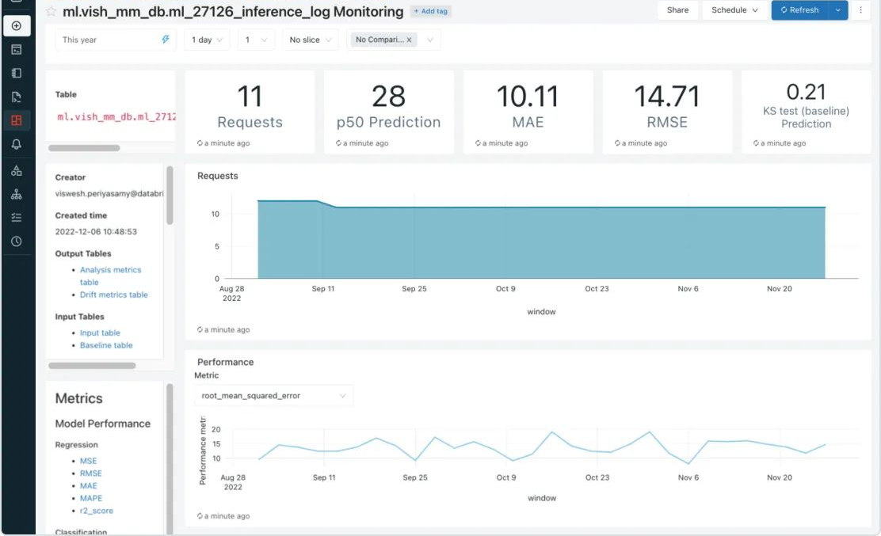


Lakehouse Monitoring
Unified monitoring for reliable, insightful, and simple data-to-AI pipelines
Simple: Log inference tables automatically, and generate metric tables and SQL dashboards.
Proactive: Automate alerts on table quality and custom metrics, and diagnose data or model issues.
Integrated: Track end-to-end lineage in the Unity Catalog for training data, feature tables, models, and inference logs, for simpler governance.
©2022 Databricks Inc. — All rights reserved

Slide 22





MLﬂow Deployments Server
All of Databricks Model Serving will provide these benefits.
Manage, govern, evaluate, and switch models easily. Previously called “AI Gateway”
Central Management and Governance
Routes let users query designated models using credentials managed by their organization.
Organizations can rate-limit routes to control costs.
Routes enable logging and caching of requests for better tracking and observability.
Unified APIs for AI Models and Providers
A common API for diverse models and providers means users don’t have to familiarize themselves with vendor specific APIs and documentation.
Easily upgrade to the latest and greatest LLM without restructuring the rest of your code.
Enable Multiple Gen AI Use Cases
With simplified model access, developers can focus on the end product instead of infrastructure.
A common API helps future proof by providing the fiexibility to use the best models as they are released.
Cost control and operational oversight lets you responsibly scale AI and meet audit and compliance requirements.
©2023 Databricks Inc. — All rights reserved

Slide 23

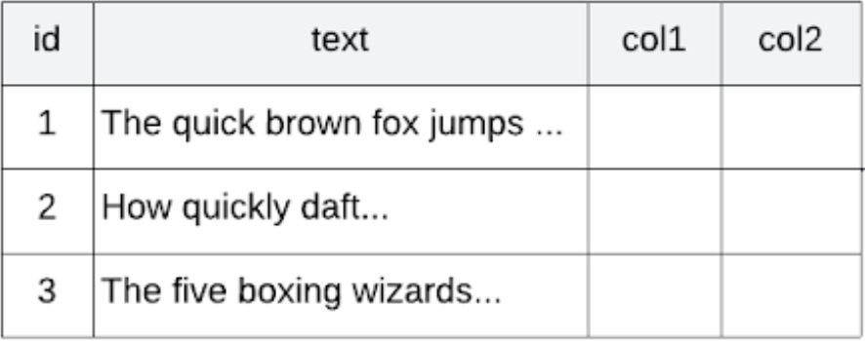




Vector Search
Create auto-updating vector indexes, managed by Unity Catalog
Choose your source table
Call a simple API to create a semantic search index
client.create_delta_sync_index( endpoint_name="storage_endpoint", index_name=f"{catalog}.{schema}.{index}", source_table_name="ml.llm.spark_docs", primary_key="id", embedding_source_column="text", ai_gateway_route_name="openai-embedding", pipeline_type="CONTINUOUS"
Call endpoint for real-time retrieval
result = index.similarity_search( query_text="What is Spark Connect?", columns=["id", "text", "link"], filters={"doctype": "wiki"})
Choose any embedding model
MLflow AI Gateway
)
Integrate with LangChain, LlamaIndex, etc.
Scale out endpoints as needed
Ingestion pipelines managed for you
Indexes managed by Unity Catalog
Also, APIs for
Unmanaged embeddings
CRUD API upsert/delete
Documentation: AWS, Azure
©2022 Databricks Inc. — All rights reserved

Slide 24
A Data Intelligence Platform enables you to truly democratize data and AI
ACCESSIBLE WITH NATURAL LANGUAGE
Everyone can quickly and easily discover insights
SIMPLE TO OPERATE
AI removes complexity and heavy lifting
STRONG GOVERNANCE AND SECURITY
Train and serve custom GenAI applications that maintain privacy
©2023 Databricks Inc. — All rights reserved

Slide 25
Use Cases References
Data & AI: The Right Way
©2023 Databricks Inc. — All rights reserved
25

Slide 26




Introduction
Andrew Kennedy
andrew.kennedy@thorogood.com linkedin.com/in/aikennedy
– Chartered Statistician, Royal Statistical Society
– Databricks Certified ML Professional
– Microsoft Certified Azure AI Engineer Associate
– AWS Certified ML Specialist
– Google Cloud Certified Professional ML Engineer

Slide 27
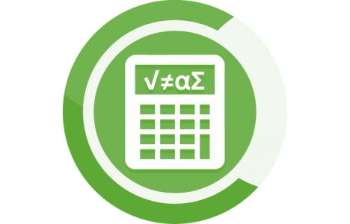





Thorogood overview
Who we are
Data & AI Specialists
Independent, customer-oriented consultancy
Operating Globally
London • Singapore • São Paulo Philadelphia • Boston • Bangalore
Strategies • Solutions • Services
Application Design & Development Planning & Business Modeling Strategies & Roadmaps
Data & Analytics Services Training & Adoption Maintenance & Support
analytics
technology
business focus
data, modeling and algorithm expertise outclassing intuition
understanding possibilities to maximize opportunities
locking onto business goals to deliver business value
The right way. | thorogood.com
Information Classification: PUBLIC | Generative AI with Databricks

Slide 28


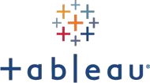

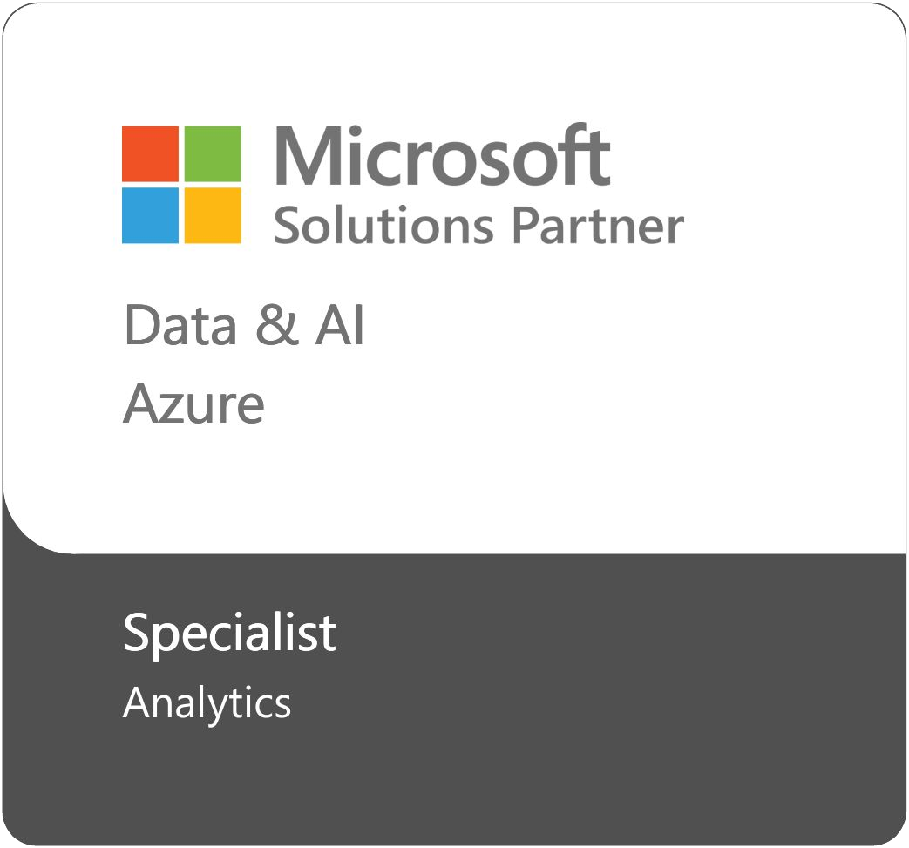
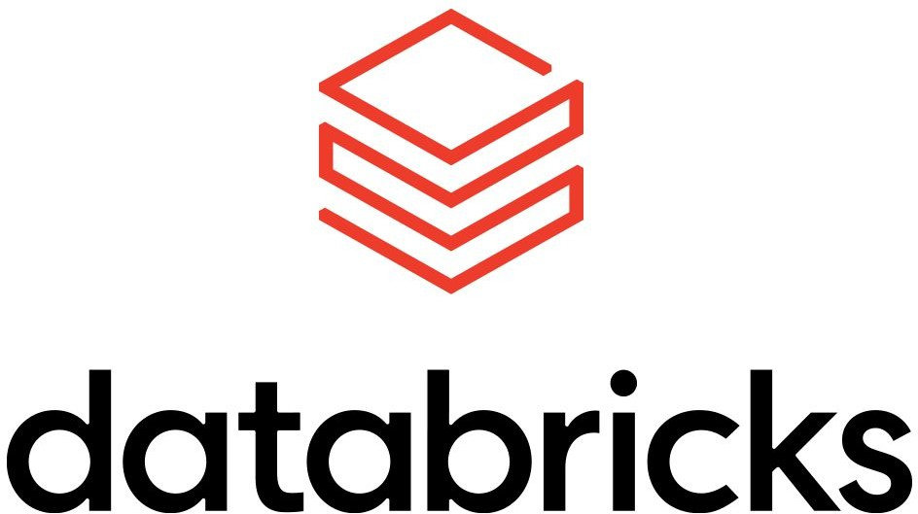




About Thorogood
Some of the technologies we work with
The right way. | thorogood.com
Information Classification: PUBLIC | Generative AI with Databricks

Slide 29

Making your content searchable
Information Classification: PUBLIC | Generative AI with Databricks

Slide 30

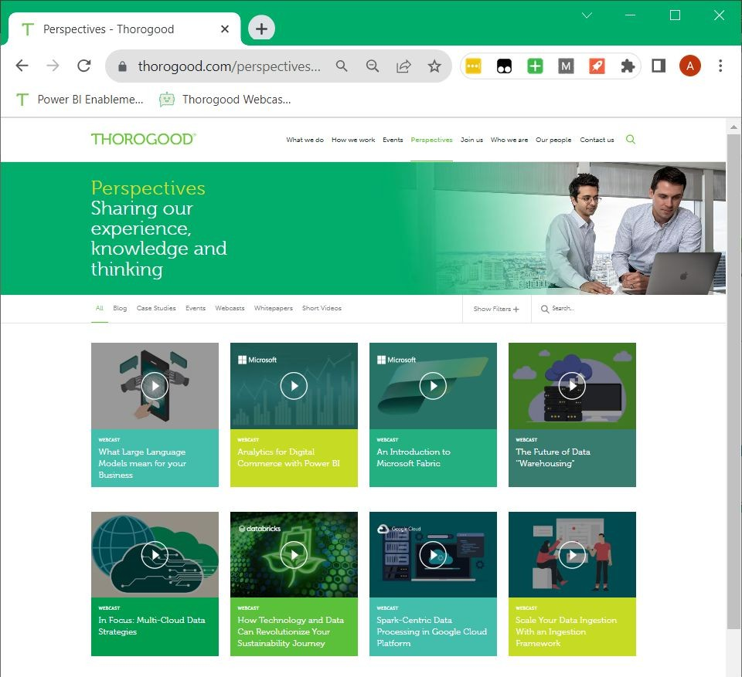

Knowledge discovery and search
Making content searchable from Thorogood’s webcast videos
How can we most easily find relevant content from videos?
The right way. | thorogood.com
Information Classification: PUBLIC | Generative AI with Databricks

Slide 31




Knowledge discovery and search
Making content searchable from Thorogood’s webcast videos
Videos
Chat Interface
Video files in cloud storage
Transcripts in cloud storage
Search Interface
Search index
The right way. | thorogood.com
Information Classification: PUBLIC | Generative AI with Databricks

Slide 32

Knowledge discovery and search
Making content searchable from Thorogood’s webcast videos
Videos
Chat Interface
Video files in cloud storage
Transcripts in cloud storage
Search Interface
Search index
Databricks
The right way. | thorogood.com
Information Classification: PUBLIC | Generative AI with Databricks

Slide 33



Knowledge discovery and search
Making content searchable from Thorogood’s webcast videos
Azure OpenAI
Videos
Azure AI Video Indexer
Azure AI Search
Chat Interface
Video files in cloud storage
Transcripts in cloud storage
Search Interface
Search index
Databricks
The right way. | thorogood.com
Information Classification: PUBLIC | Generative AI with Databricks

Slide 34




Knowledge discovery and search
Making content searchable from Thorogood’s webcast videos
LARGE LANGUAGE
MODEL
Azure OpenAI
AUDIO TRANSCRIPTION
Videos
Chat Interface
Video files in Transcripts in Search
cloud storage cloud storage Search index Interface
Databricks
Azure App Service
Azure AI Video Indexer
Azure AI Search
AI-POWERED SEARCH
The right way. | thorogood.com
Information Classification: PUBLIC | Generative AI with Databricks

Slide 35
Demo
Information Classification: PUBLIC | Generative AI with Databricks

Slide 36
Knowledge discovery and search
Making content searchable from Thorogood’s webcast videos
Azure OpenAI
Videos
Azure AI Video Indexer
Azure AI Search
Chat Interface
Video files in cloud storage
Transcripts in cloud storage
Search Interface
Search index
Databricks
The right way. | thorogood.com
Information Classification: PUBLIC | Generative AI with Databricks
36

Slide 37
Customer example
Making your content searchable
Information Classification: PUBLIC | Generative AI with Databricks
37

Slide 38

Indexing and Querying Quarterly Reports
The Business Goals
Current
Goals
Consolidate reports for easy access
Quarterly Investor Reports
Add AI-powered insights to human interpretation
Amplify the investment team’s time
The right way. | thorogood.com
Information Classification: PUBLIC | Generative AI with Databricks

Slide 39

Indexing and Querying Quarterly Reports
High level project milestones
Adding a chat interface to allow natural language queries
Customer-specific prompt engineering to improve chat responses
Project Timeline
Enable text extraction and indexing to make searching achievable
Improve tagging and index fields to allow filtering of documents
The right way. | thorogood.com
Information Classification: PUBLIC | Generative AI with Databricks

Slide 40
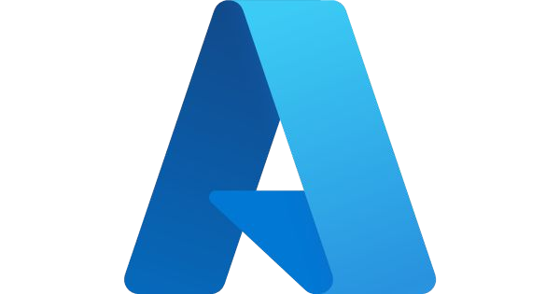





Indexing and Querying Quarterly Reports
Proposed architecture
Azure Open AI
Documents
Azure AI Document Intelligence Studio
Azure Cognitive Search
Chat Interface
Extracted text files in cloud storage
PDF Documents in cloud storage
Search index
Search Interface
Databricks
Azure App Service
The right way. | thorogood.com
Information Classification: PUBLIC | Generative AI with Databricks

Slide 41
Future vision for the solution
A stepping stones approach
Blend golden record quantitative data with qualitative data
Develop an in-house PDF quantitative data ingestion tool
Extend the functionality to other unstructured documents like meeting notes
The scope of this phase
Implement indexing, querying and chat with unstructured investor reports
The right way. | thorogood.com
Information Classification: PUBLIC | Generative AI with Databricks

Slide 42
Observations, suggestions and what next?
Information Classification: PUBLIC | Generative AI with Databricks

Slide 43
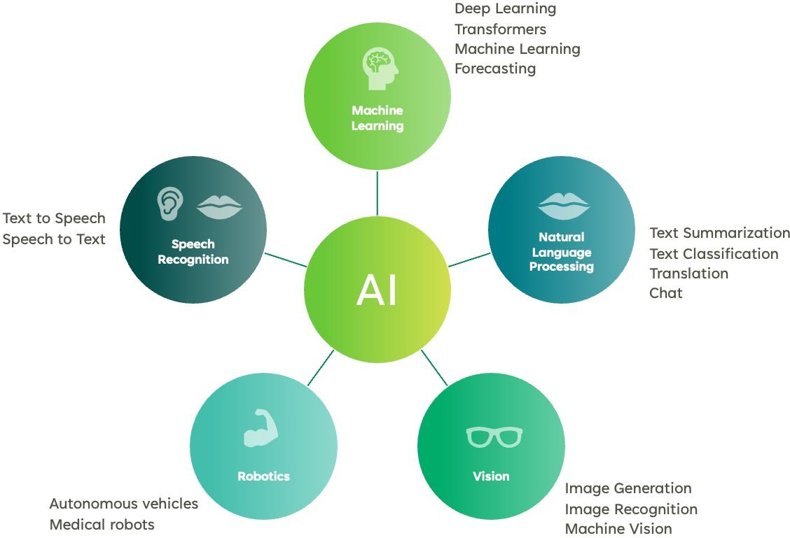
Observation and Suggestions
Focus on the business cases, and what will deliver value for your organization
Think wider than just chat models
Testing, monitoring and ongoing improvement is key
AI can build on and augment your existing data
The right way. | thorogood.com

Slide 44
As you embark on a journey into the world of Generative AI,
here’s the immediate next step…
©2023 Databricks Inc. — All rights reserved

Slide 45



What’s Next
Governing Your Data Estate in the Age of AI
Data Intelligence Day 2024
Complimentary one-hour consultation?
Register now
Register now
Sign up now
Reshape the way you perceive and implement governance in your data and AI initiatives. This webinar is tailored for data enthusiasts, business leaders, and technology professionals seeking to strike the right balance between governance and innovation in GenAI use cases.
Join us for an in-person half-day event and dive into this fundamental shift in data platforms. Whether you aim to democratize data and AI across your organization or you simply want to see how data intelligence platforms handle production-scale AI training, governance or ETL — you’ll walk away with actionable strategies.
Find the next Data Intelligence Day near you
We would like to invite you to complimentary consultation with the Thorogood team. Please register your interest here; a member of our team will reach out shortly.
©2022 Databricks Inc. — All rights reserved

Slide 46


18 April | Live Webinar
Governing Your Data Estate in the Age of AI
In this session, you’ll learn:
How to achieve governance for your Data and AI with Databricks Unity Catalog
How Unity Catalog gives data teams the power to create a single source of truth for their data and AI assets
How to streamline processes with Lakehouse AI, from managing access permissions to sharing data and AI assets across regions, clouds, and data platforms
Real-world examples of Unity Catalog (UC) governance models to illustrate effective governance strategies
Register now

Slide 47


Asia Pacific | In-person
Data Intelligence Day 2024
As AI reshapes the world, the leaders in every industry will be those who use data and AI to power their organizations. Discover the new unified platform that delivers AI for your data, and data for your AI: the Databricks Data Intelligence Platform.
Join us for an in-person half-day event and dive into this fundamental shift in data platforms. Whether you aim to democratize data and AI across your organization or you simply want to see how data intelligence platforms handle production-scale AI training, governance or ETL — you’ll walk away with actionable strategies.
Find the next Data Intelligence Day near you
Register now

Slide 48

Complete this feedback form and let us know how we can help shape your organization’s GenAI journey.

Slide 49
©2023 Databricks Inc. — All rights reserved

